Slide 1
Chapter 18 Ethers and Epoxides; Thiols and Sulfides

Slide 2
Learning Objectives
(18.1)
Names and properties of ethers
(18.2)
Preparing ethers
(18.3)
Reactions of ethers: Acidic cleavage
(18.4)
Reactions of ethers: Claisen rearrangement
(18.5)
Cyclic ethers: Epoxides

Slide 3
Learning Objectives
(18.6)
Reactions of epoxides: Ring-Opening
(18.7)
Crown ethers
(18.8)
Thiols and sulfides
(18.9)
Spectroscopy of ethers

Slide 4
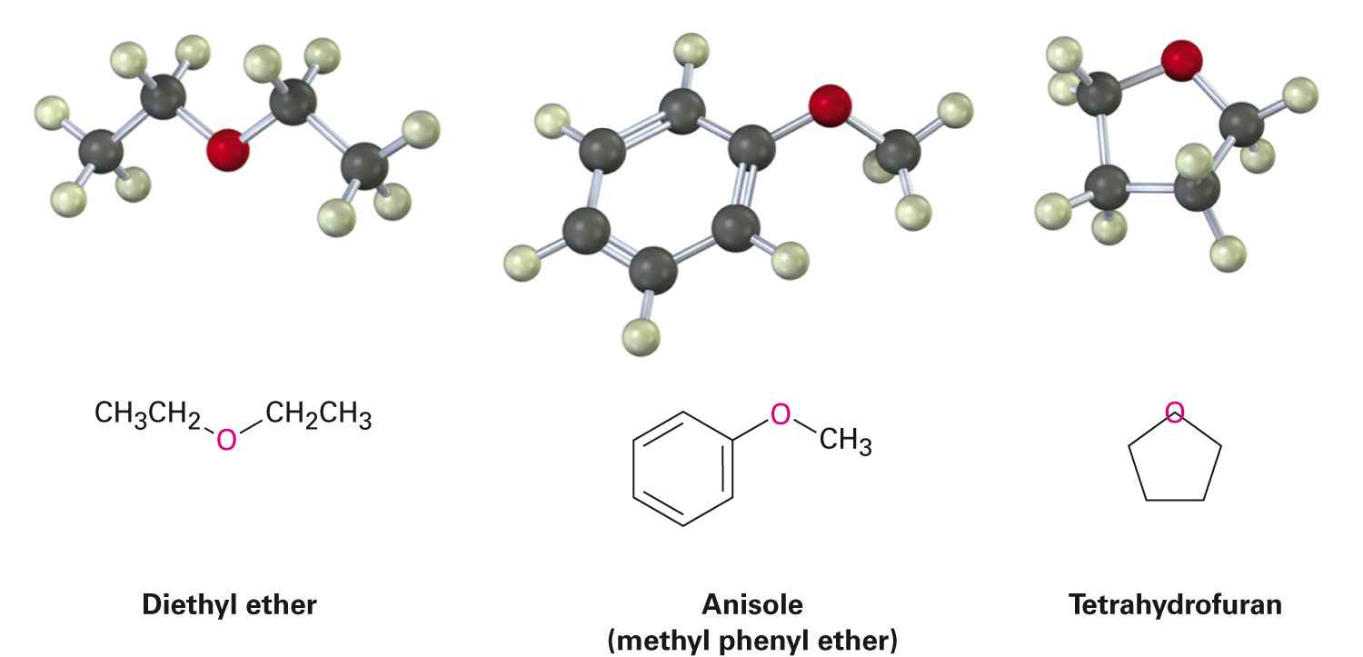
Ethers
Ethers (R–O–R’): Organic derivatives of water, having two organic groups bonded to the same oxygen atom

Slide 5
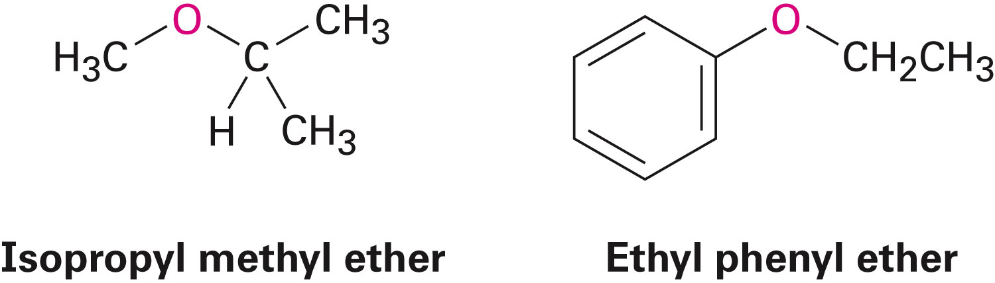
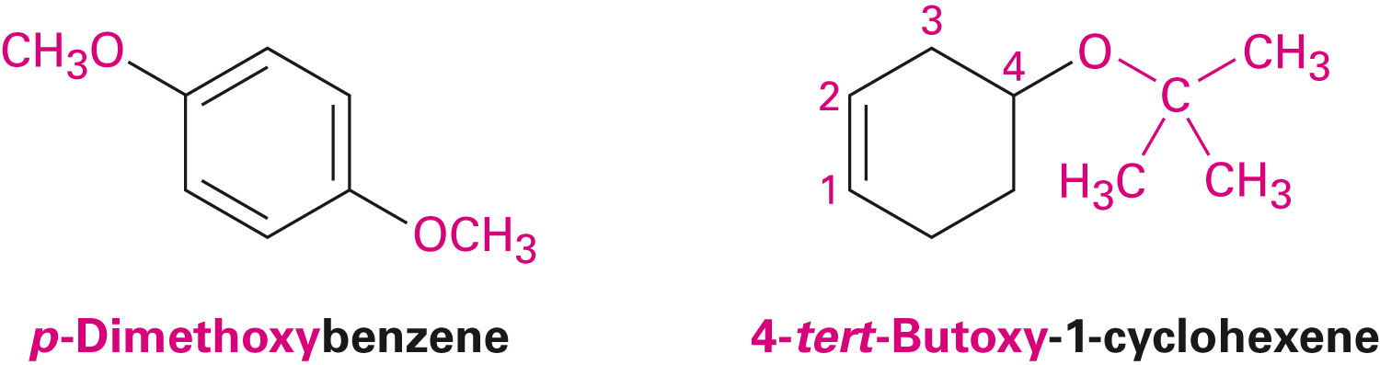
Names and Properties of Ethers
Simple ethers are named by identifying two organic substituents and adding the word ether
If other functional groups are present, the ether part is considered an alk-oxy substituent
Notes:
Names and Properties of Ethers

Slide 6
Names and Properties of Ethers
Posses nearly the same geometry as water
Bond angles of R–O–R bonds are approximately tetrahedral
Oxygen atom is sp³-hybridized
Relatively stable and unreactive in many aspects
Very useful as solvents in the laboratory
Notes:
Names and Properties of Ethers

Slide 7
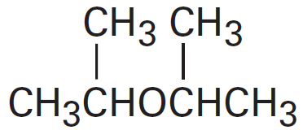

Worked Example
Name the following ethers:
a) b)
Solution:
a) Di-isopropyl ether
b) Allyl vinyl ether
Notes:
Names and Properties of Ethers

Slide 8
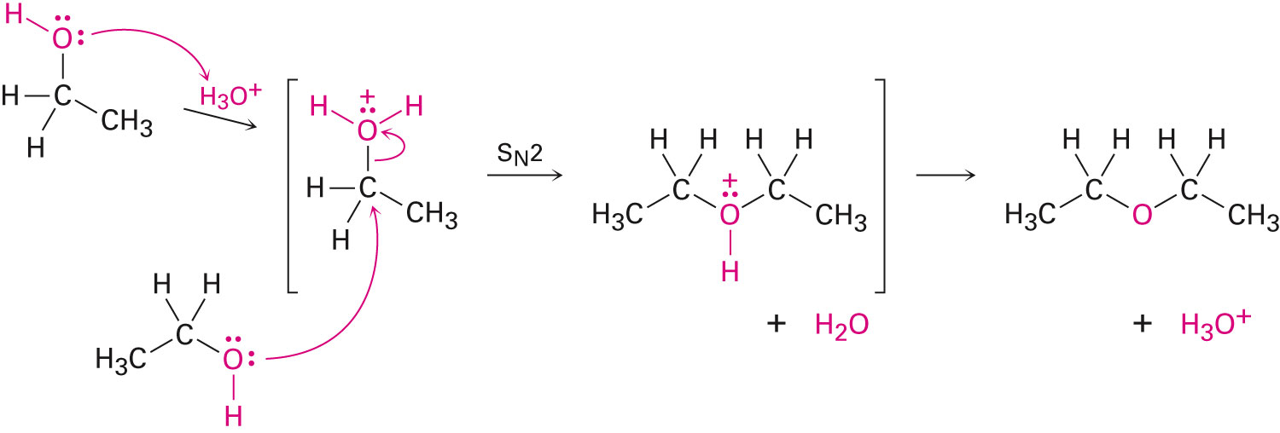
Synthesis of Ethers
Prepared industrially by sulfuric-acid-catalyzed reaction of alcohols
Limited to use with primary alcohols
Notes:
Preparing Ethers

Slide 9
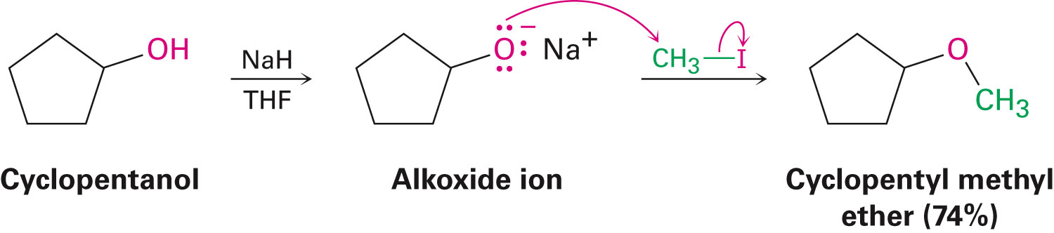
Williamson Ether Synthesis
Reaction of metal alkoxides and primary alkyl halides and tosylates in an S_{N}2 reaction
Best method for the preparation of ethers
Alkoxides are prepared by reaction of an alcohol with a strong base such as sodium hydride, NaH
Notes:
Preparing Ethers

Slide 10
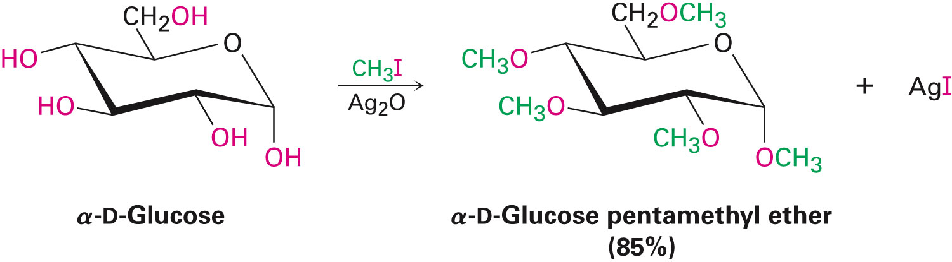
Silver Oxide-Catalyzed Ether Formation
Reaction of alcohols with Ag₂O directly with alkyl halide forms ether in one step
Glucose reacts with excess iodomethane in the presence of Ag₂O to generate a pentaether in 85% yield
Notes:
Preparing Ethers

Slide 11
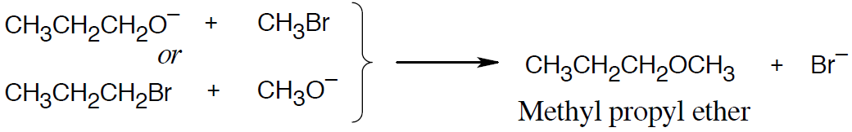
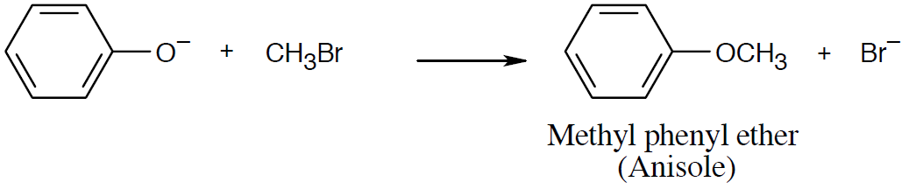
Worked Example
How are the following ethers prepared using a Williamson synthesis?
a) Methyl propyl ether
b) Anisole (methyl phenyl ether)
Solution:
a)
b)
Notes:
Preparing Ethers

Slide 12
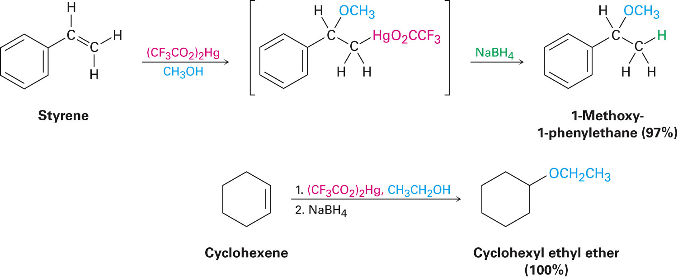
Alkoxymercuration of Alkenes
Alkene is treated with an alcohol in the presence of mercuric acetate or trifluoroacetate
Demercuration with NaBH₄ yields an ether
Overall Markovnikov addition of alcohol to alkene
Notes:
Preparing Ethers

Slide 13
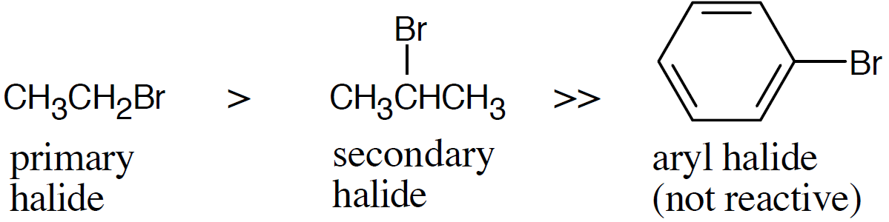
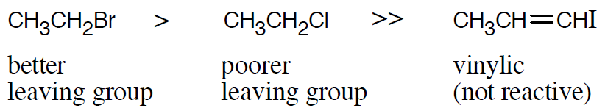
Worked Example
Rank the following halides in order of their reactivity in Williamson synthesis:
a) Bromoethane, 2-bromopropane, bromobenzene
b) Chloroethane, bromoethane, 1-iodopropene
Solution:
Most reactive Least reactive
a)
b)
Notes:
Preparing Ethers

Slide 14
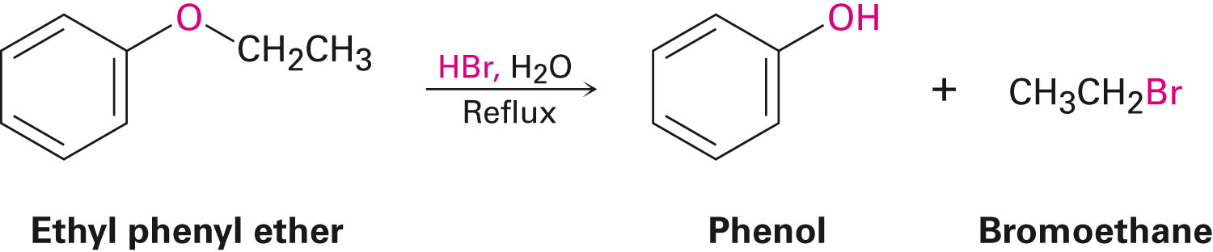
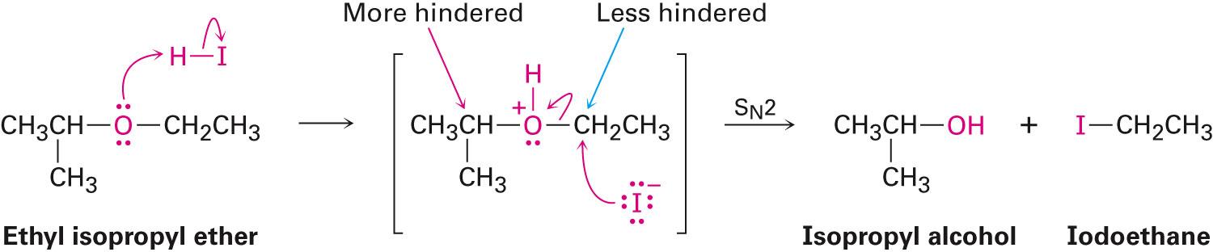
Reactions of Ethers: Acidic Cleavage
Cleaved by strong acids
HI, HBr produce an alkyl halide from less hindered component by S_{N}2
Notes:
Reactions of Ethers: Acidic Cleavage

Slide 15
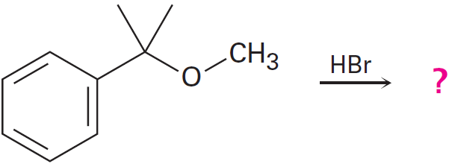
Worked Example
Predict the product(s) of the following reaction:
Solution:
A primary alkyl group and a tertiary alkyl group is bonded to the ether oxygen
When one group is tertiary, cleavage occurs by an S_{N}1 or E1 route to give either an alkene or a tertiary halide and a primary alcohol
Notes:
Reactions of Ethers: Acidic Cleavage

Slide 16
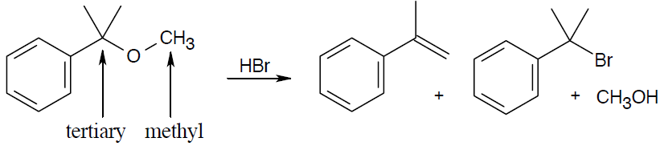
Worked Example
Notes:
Reactions of Ethers: Acidic Cleavage

Slide 17
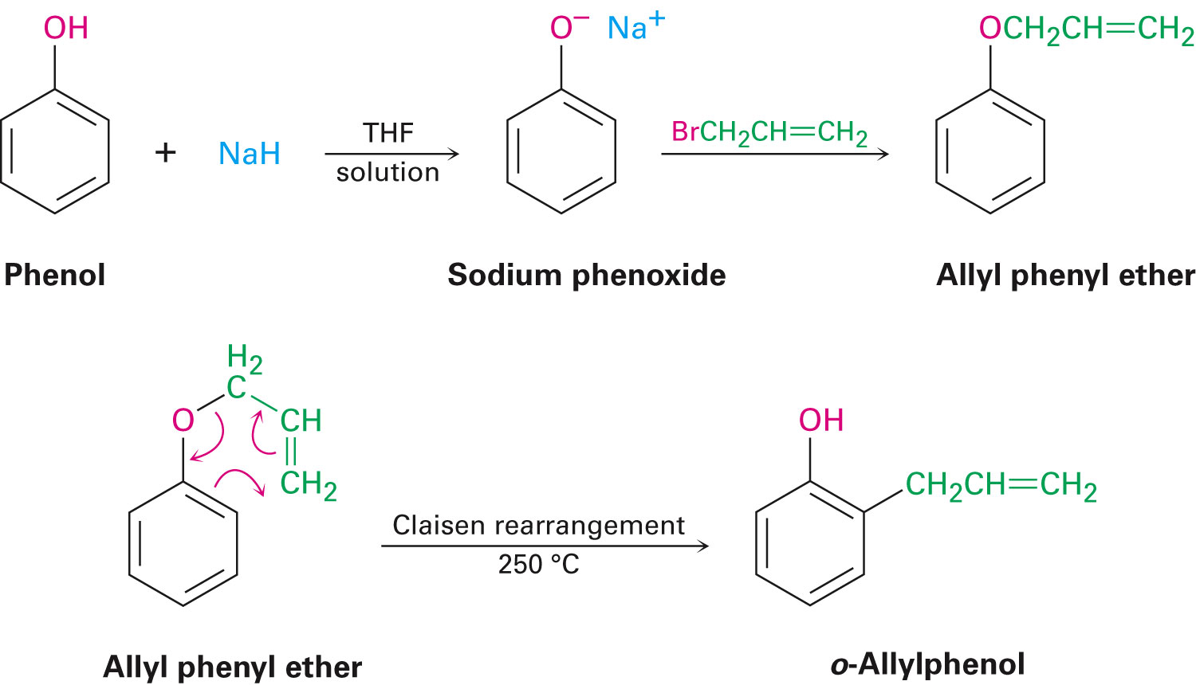
Reactions of Ethers: Claisen Rearrangement
Specific to allyl aryl ethers and allyl vinyl ethers
Caused by heating ally aryl ether to 200-250°C
Leads to an o-allylphenol
Result is alkylation of the phenol in an ortho position
Notes:
Reactions of Ethers: Claisen Rearrangement

Slide 18
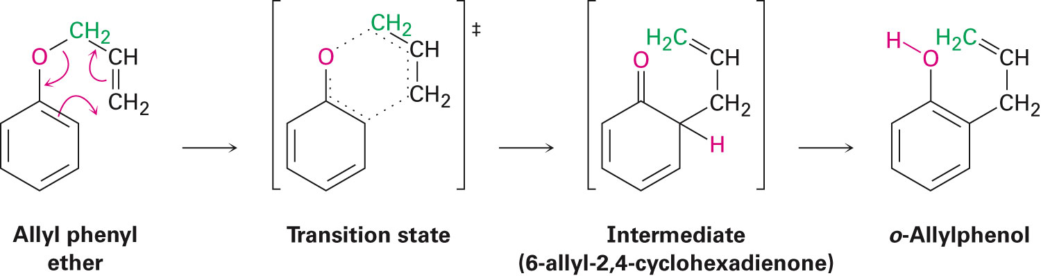
Reactions of Ethers: Claisen Rearrangement
Takes place in a single step through a pericyclic mechanism
Reorganization of bonding electrons of a six-membered, cyclic transition state
Mechanism is consistent with ¹⁴C labeling
Notes:
Reactions of Ethers: Claisen Rearrangement

Slide 19
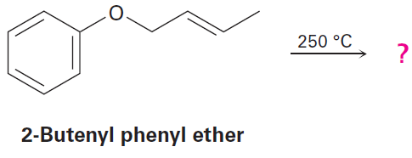
Worked Example
What products are expected from Claisen rearrangement of 2-butenyl phenyl ether?
Solution:
Six bonds will either be broken or formed in the product - Represented by dashed lines in the transition state
Redrawing bonds to arrive at the intermediate enone, which rearranges to the more stable phenol
Notes:
Reactions of Ethers: Claisen Rearrangement

Slide 20
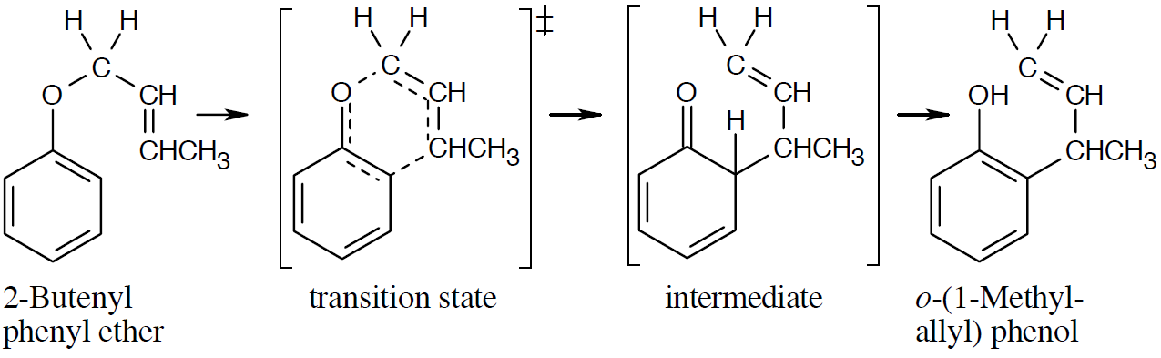
Worked Example
Notes:
Reactions of Ethers: Claisen Rearrangement

Slide 21
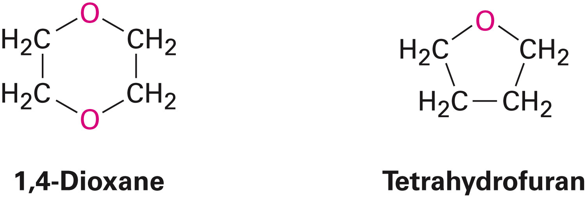
Cyclic Ethers
Behave like acyclic ethers with the exception of three-membered ring called epoxides
Strain of the three-membered ring gives epoxides a unique chemical reactivity
Dioxane and tetrahydrofuran are used as solvents
Notes:
Cyclic Ethers: Epoxides

Slide 22
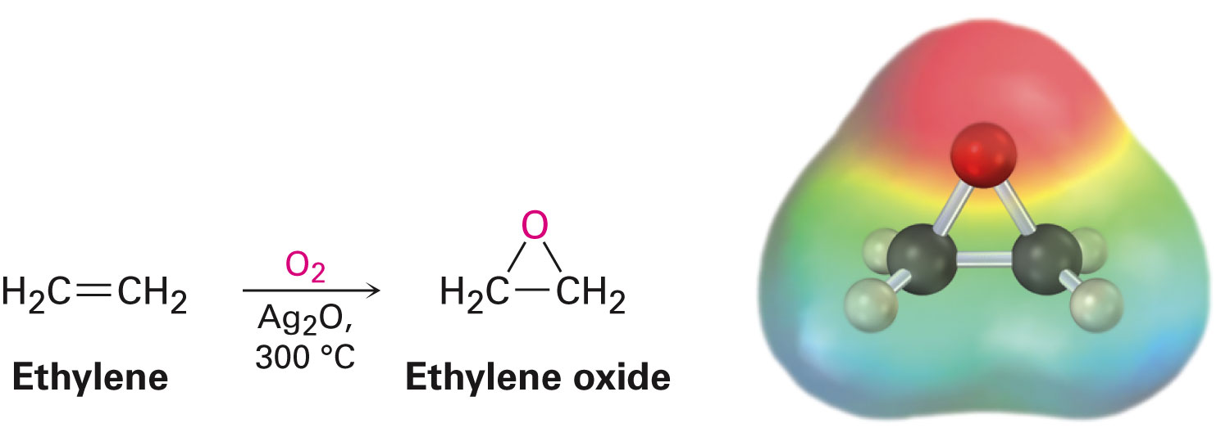
Cyclic Ethers
Also called epoxides
Ethylene oxide is industrially important as an intermediate
Prepared by reaction of ethylene with oxygen at 300 °C over a silver oxide catalyst
-ene ending implies the presence of a double bond in the molecule
Notes:
Cyclic Ethers: Epoxides

Slide 23
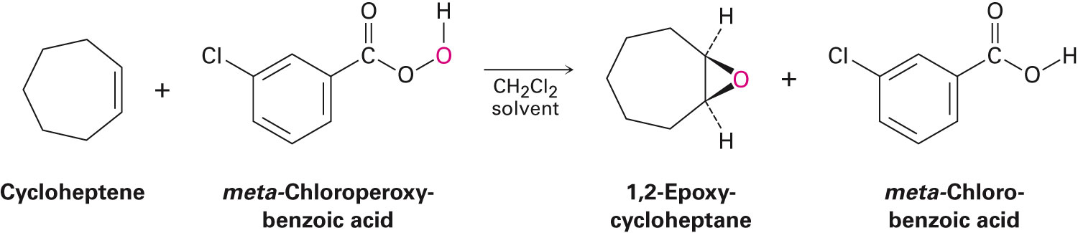
Preparation of Epoxides
By treating alkenes with a peroxyacid (RCO₃H)
Also prepared from halohydrins
Notes:
Cyclic Ethers: Epoxides

Slide 24
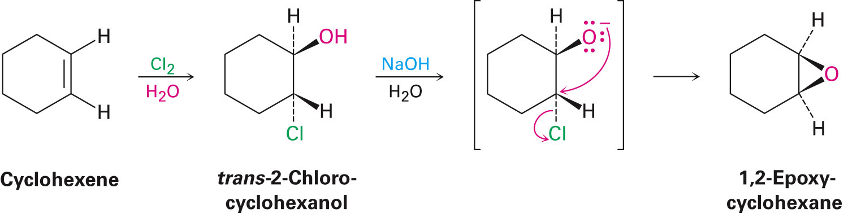
Epoxides from Halohydrins
Addition of HO–X to an alkene gives a halohydrin
Treatment of a halohydrin with base gives an epoxide
Intramolecular Williamson ether synthesis
Notes:
Cyclic Ethers: Epoxides

Slide 25
Worked Example
Explain why reaction of cis-2-butene with m-chloroperoxybenzoic acid yields an epoxide different from that obtained by reaction of the trans isomer
Solution:
Epoxidation, in this case, is a syn addition of oxygen to a double bond
Original bond stereochemistry is retained; product is a meso compound
Notes:
Cyclic Ethers: Epoxides

Slide 26
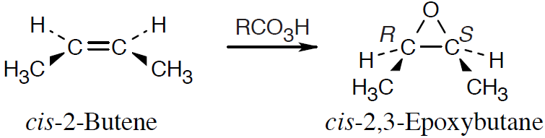
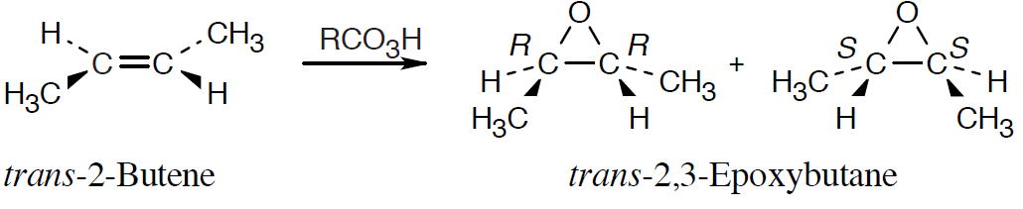
Worked Example
In the epoxide product the methyl groups are cis
Reaction of trans-2-butene with m-chloroperoxybenzoic acid yields trans-2,3 epoxybutane
Notes:
Cyclic Ethers: Epoxides

Slide 27
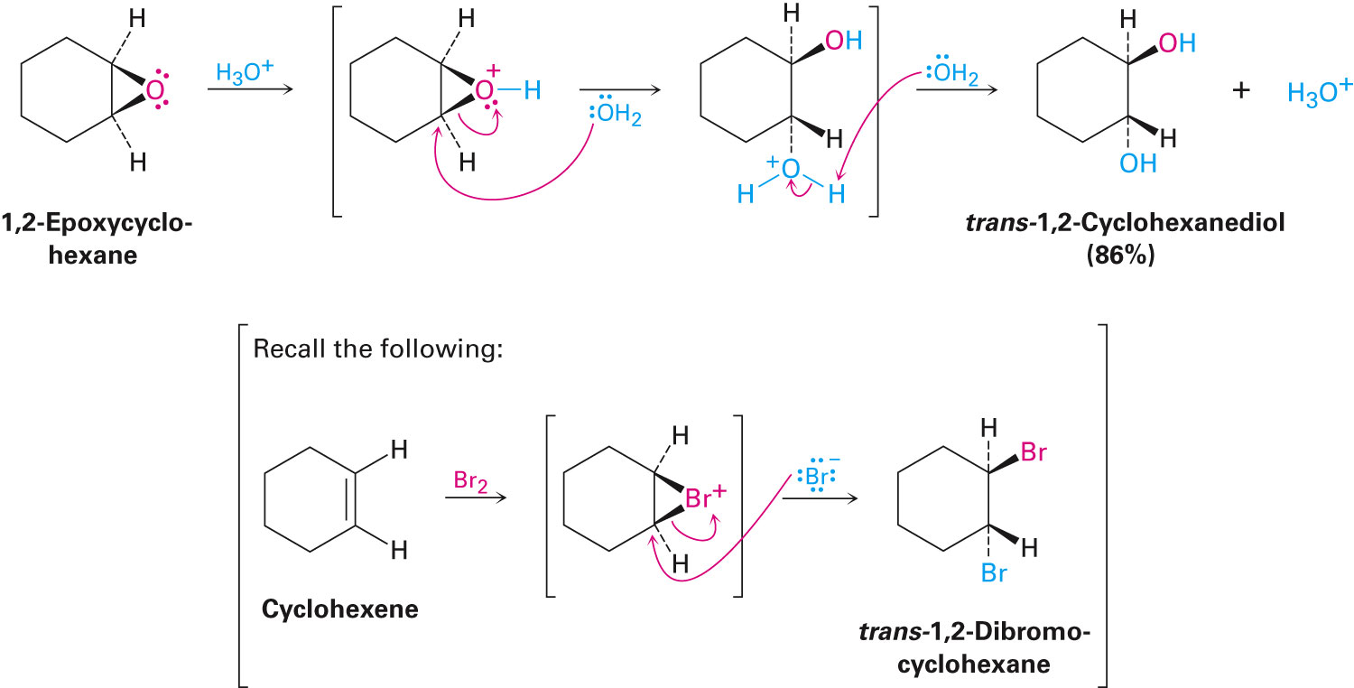
Reactions of Epoxides: Ring-Opening
Water adds to epoxides with dilute acid at room temperature
Product is a 1,2-diol
Notes:
Reactions of Epoxides: Ring-Opening

Slide 28
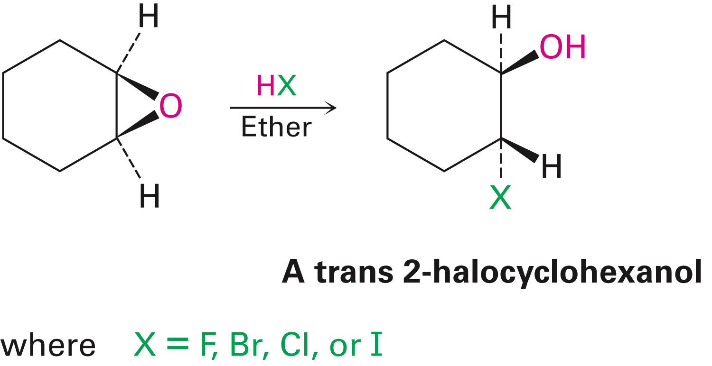
Reactions of Epoxides: Ring-Opening
Also can be opened by reaction with acids other than H₃O⁺
Anhydrous HF, HBr, HCl, or HI combine with an epoxide
Gives a trans product
Notes:
Reactions of Epoxides: Ring-Opening

Slide 29
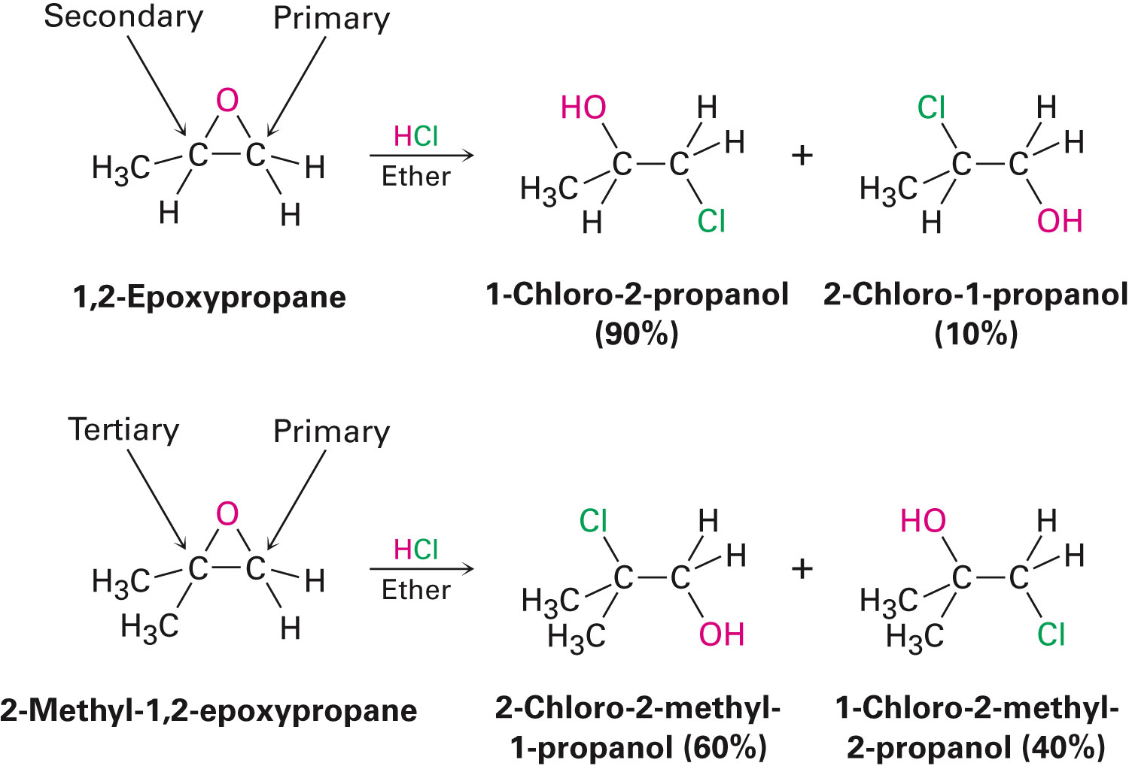
Reactions of Epoxides: Ring-Opening
Regiochemistry of acid-catalyzed ring-opening depends on the epoxide’s structure
Nucleophilic attack occurs primarily at the more highly substituted site, when one epoxide carbon atoms is tertiary
Notes:
Reactions of Epoxides: Ring-Opening

Slide 30
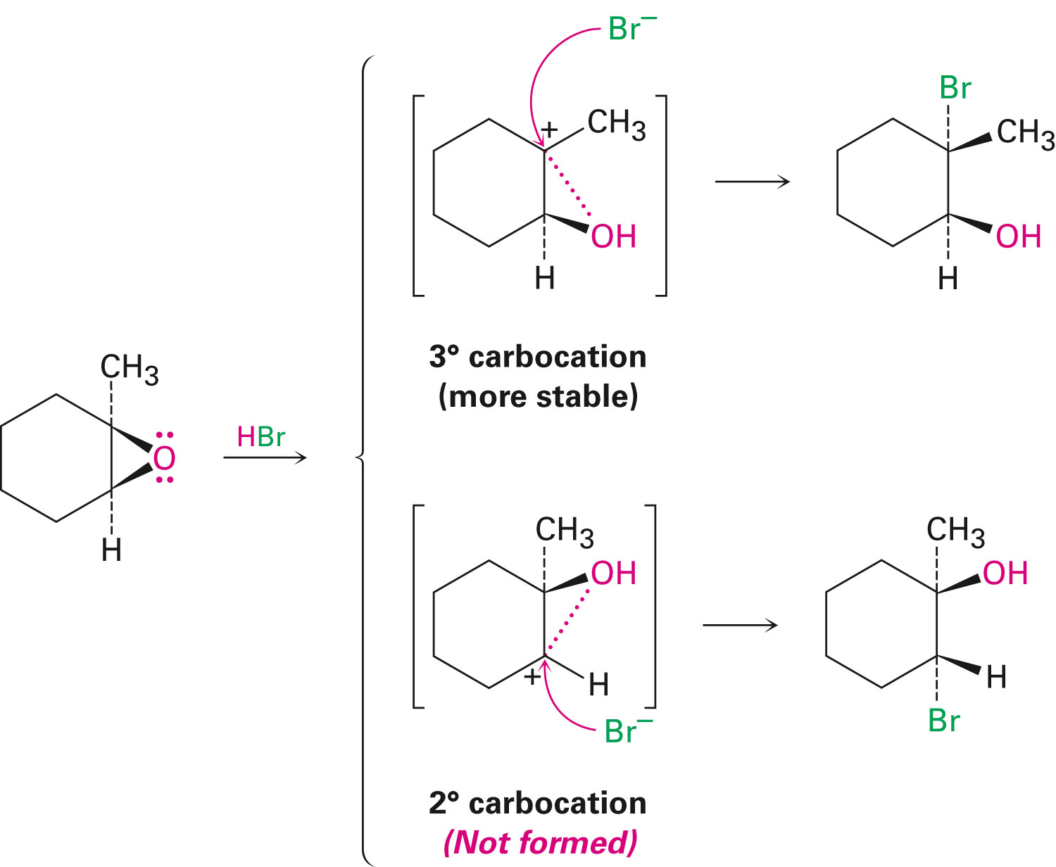
Figure 18.2 - Ring-Opening of 1,2-epoxy-1-methylcyclohexane with HBr
Notes:
Reactions of Epoxides: Ring-Opening

Slide 31
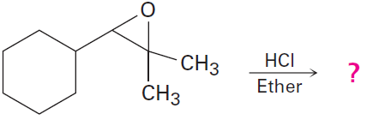
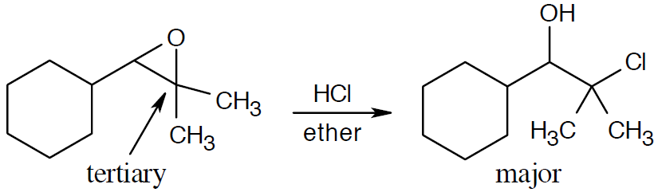
Worked Example
Predict the major product of the following reaction:
Solution:
Notes:
Reactions of Epoxides: Ring-Opening

Slide 32
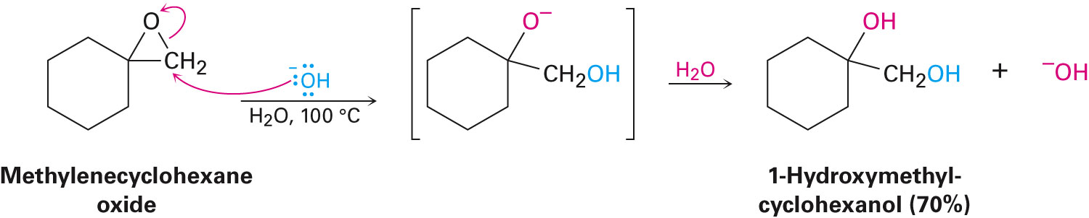
Base-Catalyzed Epoxide Opening
Epoxide rings can be cleaved by bases, nucleophiles, and acids
Strain of the three-membered ring is relieved on ring-opening
Hydroxide cleaves epoxides at elevated temperatures
Notes:
Reactions of Epoxides: Ring-Opening

Slide 33
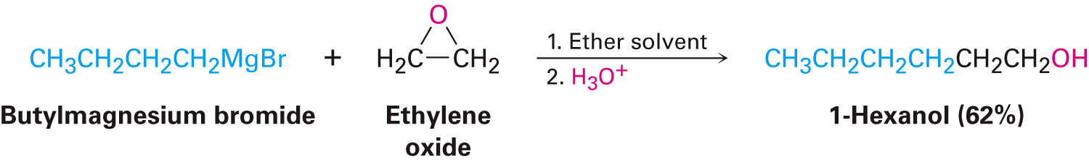
Base-Catalyzed Epoxide Opening
Amines and Grignard reagents can be used for epoxide opening
Ethylene oxide is frequently used
Allows conversion of a Grignard reagent into a primary alcohol
Notes:
Reactions of Epoxides: Ring-Opening

Slide 34
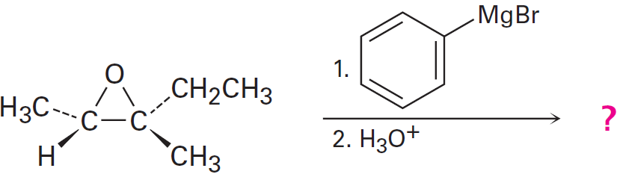
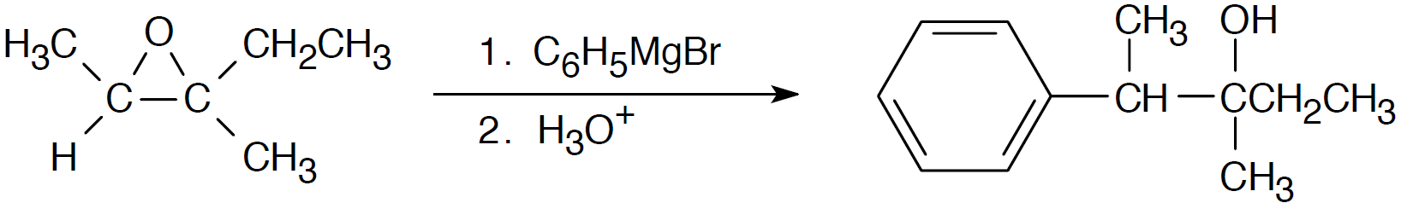
Worked Example
Predict the major product of the following reaction:
Solution:
Addition of a Grignard reagent takes place at the less substituted epoxide carbon
Notes:
Reactions of Epoxides: Ring-Opening

Slide 35
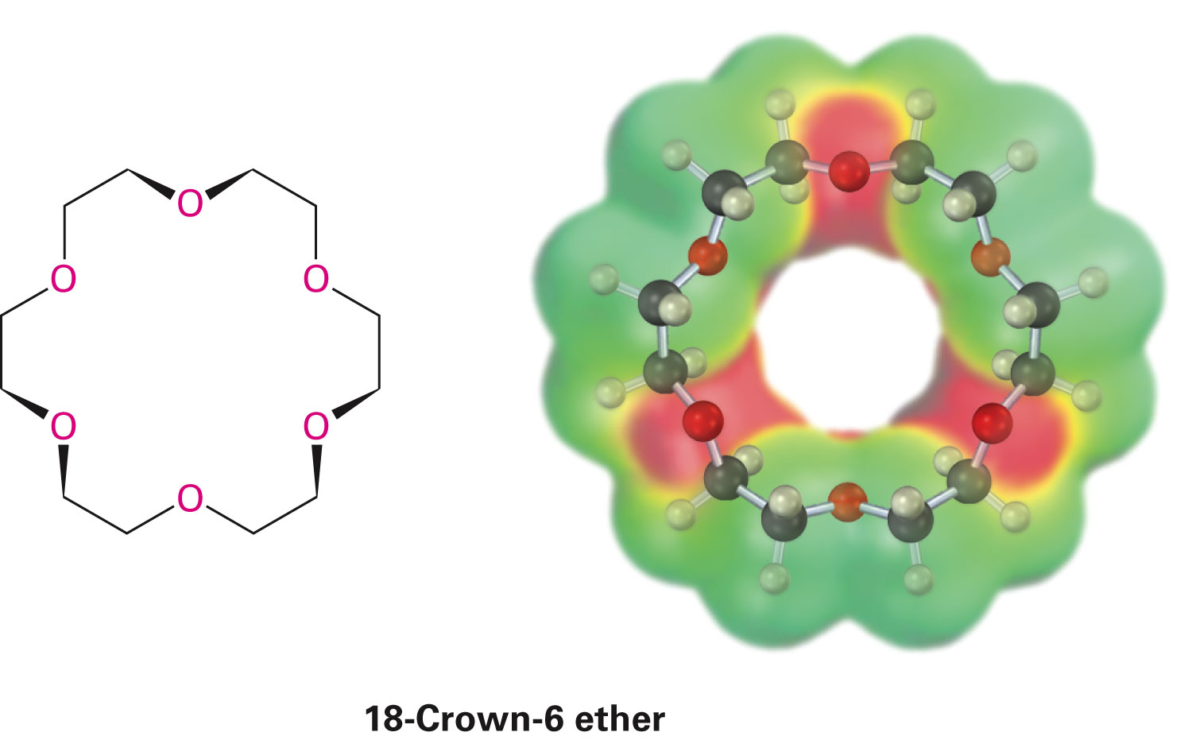
Crown Ethers
Large-ring polyethers
Named as x-crown-y
x is total number of atoms in the ring
y is the number of oxygen atoms
Central cavity is electronegative and attracts cations
Notes:
Crown Ethers

Slide 36
Crown Ethers
Produce similar effects when used to dissolve an inorganic salt in a hydrocarbon to that of dissolving the salt in a polar aprotic solvent
Ionophores posses ion-binding properties
Notes:
Crown Ethers

Slide 37
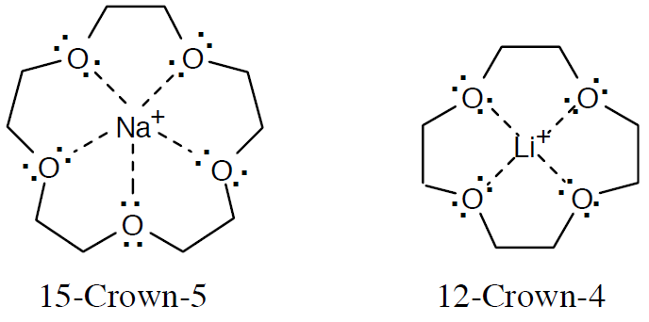
Worked Example
15-Crown-5 and 12-crown-4 ethers complex Na⁺ and Li⁺, respectively
Make models of these crown ethers, and compare the sizes of the cavities
Solution:
Bases on ionic radii, the ion-to-oxygen distance in 15-crown-5 is about 40% longer than the ion-to-oxygen distance in 12-crown-4
Notes:
Crown Ethers

Slide 38
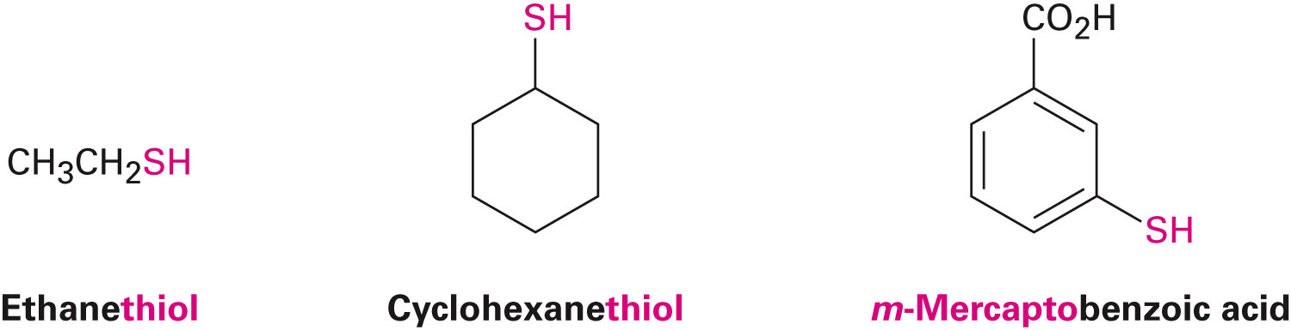
Thiols and Sulfides
Thiols
Sulfur analogs of alcohols
Named with the suffix –thiol
–SH group is called mercapto group
Notes:
Thiols and Sulfides

Slide 39
Thiols
Prepared from alkyl halides by S_{N}2 displacement with a sulfur nucleophile
Alkylthiol product can undergo further reaction with the alkyl halide
Gives symmetrical sulfide, a poorer yield of the thiol
Notes:
Thiols and Sulfides

Slide 40
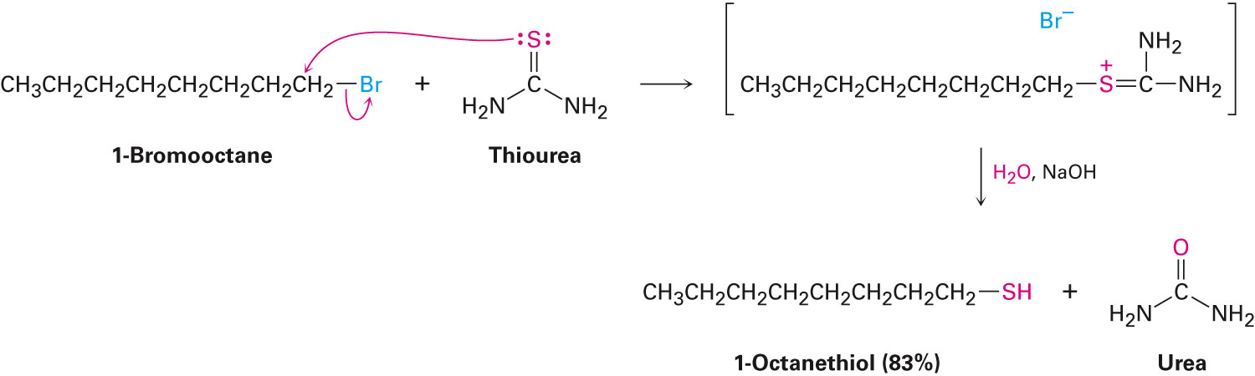
Thiols
Pure alkylthiol thiourea is used as the nucleophile
Gives an intermediate alkyl isothiourea salt, hydrolyzed by subsequent reaction with an aqueous base
Notes:
Thiols and Sulfides

Slide 41
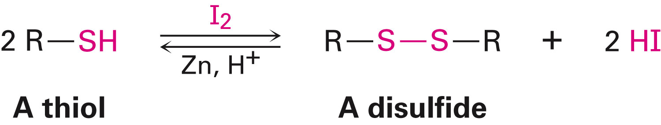
Thiols
Can be oxidized by Br₂ or I₂
Yields disulfides (RSSR’)
Reaction is reversible
Key part of numerous biological processes
Reduction back to the thiol requires the coenzyme, reduced FADH₂
Notes:
Thiols and Sulfides

Slide 42
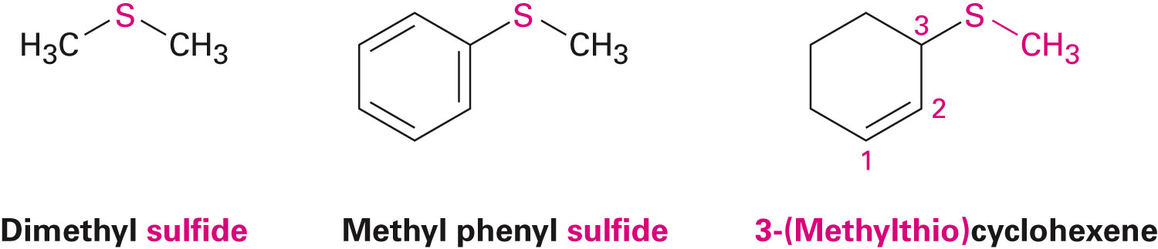
Sulfides
Sulfur analogues of ethers
Named by rules used for ethers, with sulfide in place of ether for simple compounds and alkylthio in place of alkoxy
Thiols when treated with a base gives corresponding thiolate ion
Notes:
Thiols and Sulfides

Slide 43
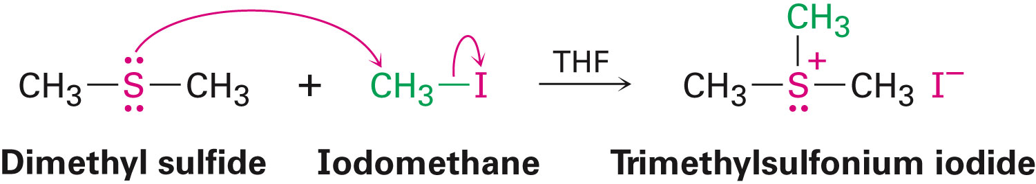
Sulfides
Thiols can undergo further reaction with the alkyl halide to give a sulfide
Sulfides and ethers differ substantially in their chemistry
Through S_{N}2 mechanism, dialkyl sulfides react rapidly with primary alkyl halides to give sulfonium ions
Notes:
Thiols and Sulfides

Slide 44
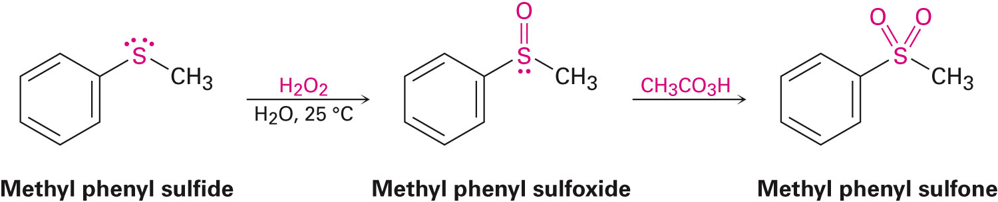
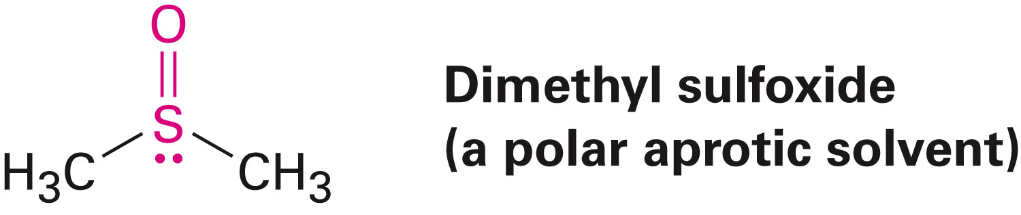
Oxidation of Thiols
Easily oxidized through treatment of a sulfide with hydrogen peroxide at room temperature
Yields sulfoxide
Further oxidation of the sulfoxide with a peroxyacid yields a sulfone
Dimethyl sulfoxide is often used as a polar aprotic solvent
Notes:
Thiols and Sulfides

Slide 45
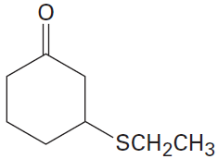
Worked Example
Name the following compound:
Solution:
3-(Ethylthio)cyclohexanone
Notes:
Thiols and Sulfides

Slide 46
Spectroscopy of Ethers
Infrared Spectroscopy
C–O single-bond stretching 1050 to 1150 cm⁻¹ overlaps many other absorptions
Nuclear magnetic resonance spectroscopy
H on a C next to ether O is shifted downfield to 3.4 δ to 4.5 δ
In epoxides, these H’s absorb at 2.5 δ to 3.5 δ in their ¹H NMR spectra
Ether C’s exhibit a downfield shift to 50 δ to 80 δ
Notes:
Spectroscopy of Ethers

Slide 47
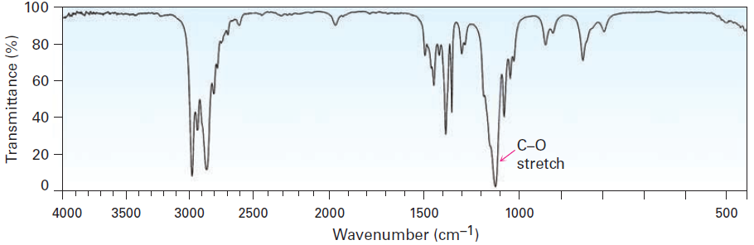
Figure 18.3 - The Infrared Spectrum of Diethyl Ether
Notes:
Spectroscopy of Ethers

Slide 48
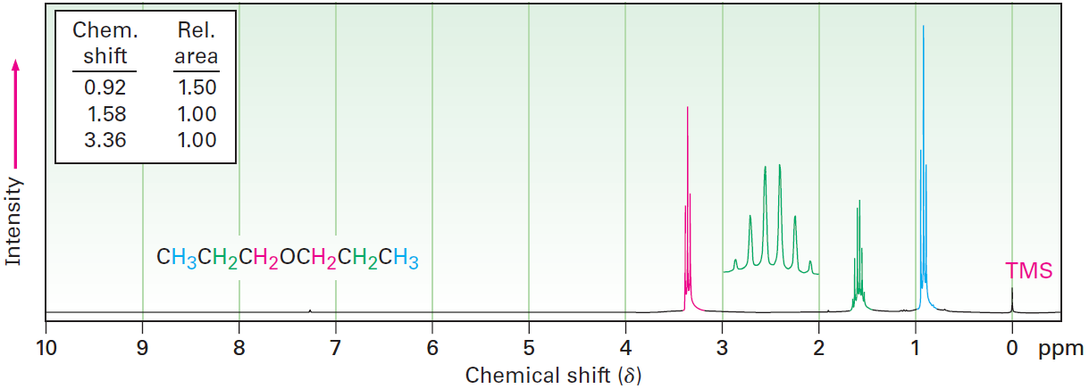
Figure 18.5 - The ¹H NMR Spectrum of Dipropyl Ether
Notes:
Spectroscopy of Ethers

Slide 49
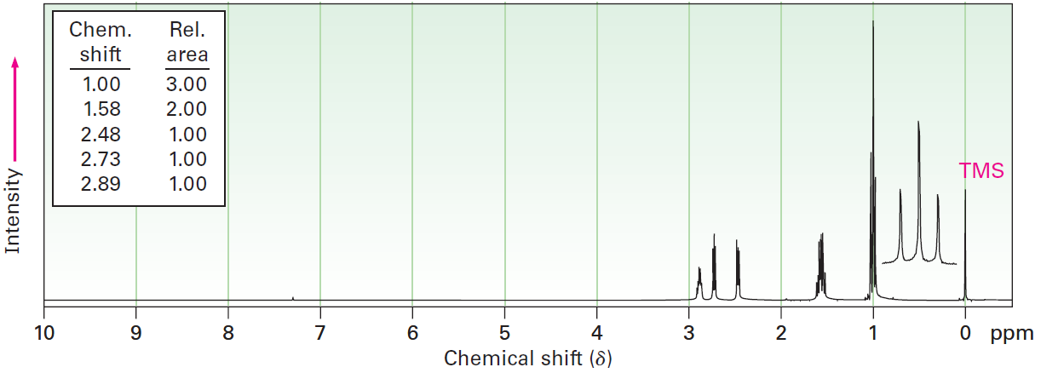
Worked Example
The ¹H NMR spectrum shown is that of a cyclic ether with the formula C₄H₈O
Propose a structure
Notes:
Spectroscopy of Ethers

Slide 50
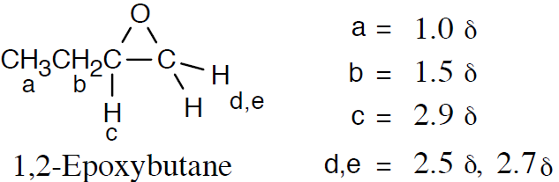
Worked Example
Solution:
Notes:
Spectroscopy of Ethers

Slide 51
Summary
Compounds that have two organic groups bonded to the same oxygen atom are called ethers
Ethers are prepared either by Williamson ether synthesis or the alkoxymercuration reaction
Allyl aryl ethers and allyl vinyl ethers undergo Claisen rearrangement to give o-allylphenols and g,d-unsaturated ketones
Thiols are sulfur analogs of alcohols

Slide 52
Summary
Disulfide can be obtained through mild oxidation of a thiol
Sulfides are sulphur analogs of ethers
Alkylation of sulphides with a primary alkyl halide will yield a sulfonium ion
Sulfides can also be oxidized to sulfoxides and to sulfones

